Slide 1
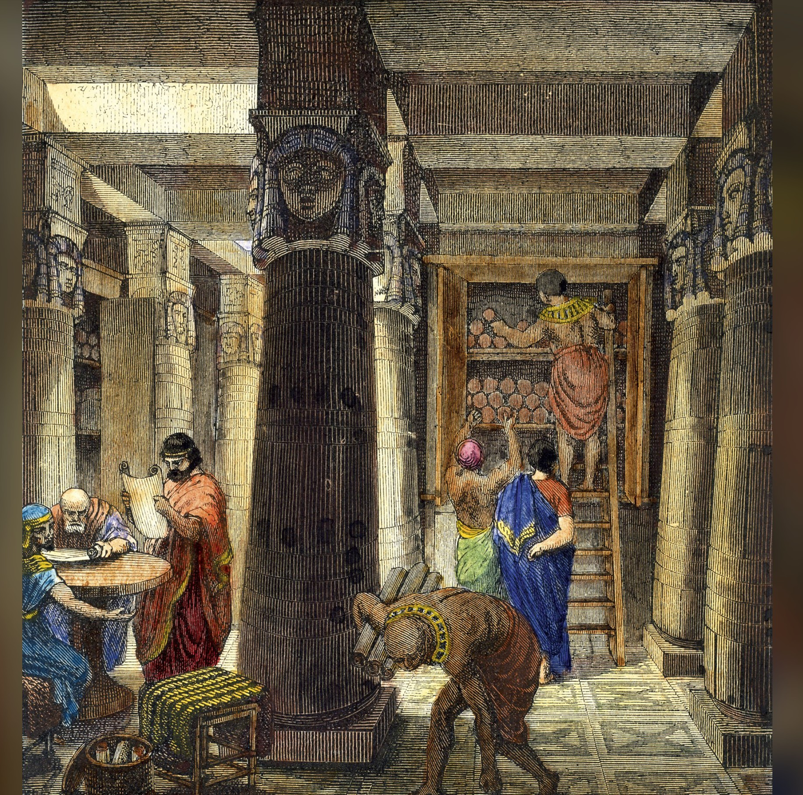
Internet Archive
Deniz Turgut
p2800389

Slide 2
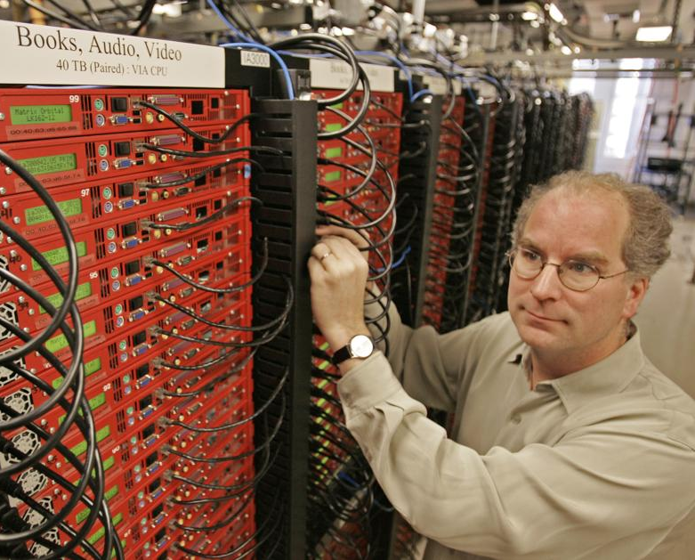
Brief history
Founded by Brewster Kahle and Bruce Gilliat in May 1996
Ensure access to all knowledge
Digital age’s Library of Alexandria
2001: launched Wayback Machine
Notes:
1.Founded in May 1996 by Brewster Kahle Bruce Gilliat, non-profit org
2.Important for preservation of digital content, including educational, that is rapidly being removed.
3.Brewster’s mission was to build digital age’s its own Library of Alexandria and ensure access to all knowledge.

Slide 3
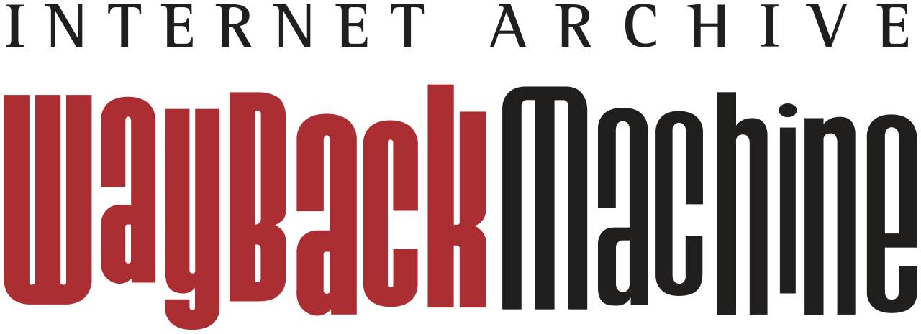
Saves a snapshot of web pages
Content submitted by users
Used for various different reasons
Allows us to see how pages looked like in the past
1400+ libraries help identify important pages
Content may be taken down for privacy or copyright reasons
Notes:
How it works: Automated web crawlers (and manual submissions via "Save Page Now") collect and store snapshots, which are linked by timestamps. Each file (HTML, images, scripts) is captured separately and linked to maintain the page’s original appearance
Used by: Journalists, researchers, SEO professionals, cybersecurity experts, and educators use it for fact-checking, legal research
Lots of pages are removed daily, by using wayback machine we can protect parts of internet from disappearing forever
Not everything works of course, if a page requires authentication for example it wont load
Eventhough a lot of the digital content falls under digital fair use, issues arise.
Removal requests are available for privacy or copyright

Slide 4

How much content is stored?
1 trillion web pages
56 million books and texts
13 million audio recordings (280,000 live concerts)
15 million videos
5.3 million images
1.3 million software programs
Notes:
15 million videos including 3.3 million TV news programs
Possibly including your Minecraft letsplays from 2012
How much space do you think all of these take?

Slide 5
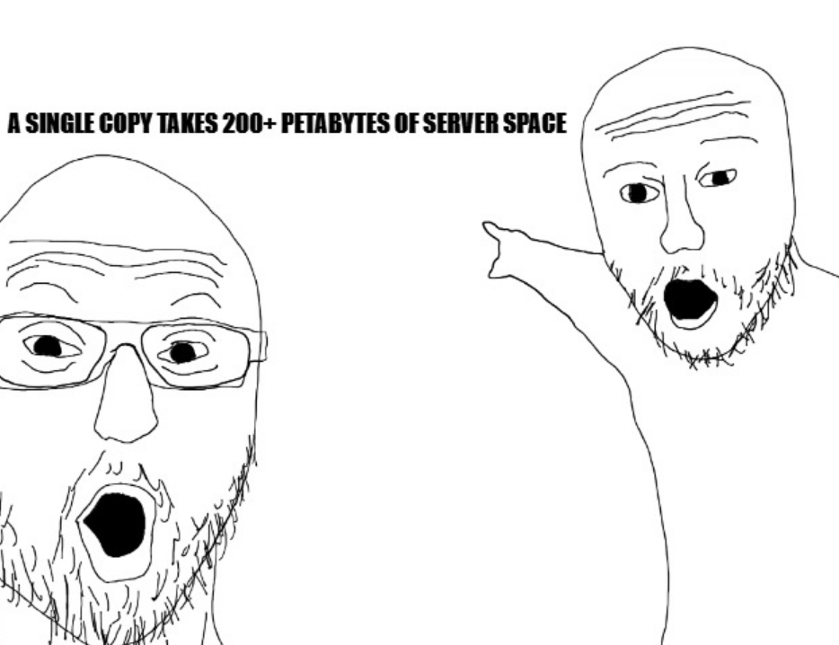
Notes:
A single copy of the IA library collection takes 200+ Petabytes of server space! (And there are 2 copies)

Slide 6

Federal Depository Library Program
Official part of FDLP since July 24th 2025
Host official US government documents
Bills, laws, regulations and presidential materials
Notes:
As of July 24th 2025, the IA is officially part of the Federal Depository Library Program, meaning they are able to host official US government documents.
These documents are:
Bills, laws, regulations and presidential materials
Keep in mind that this does NOT grant the American Federal government to take control over IA.

Slide 7

Cyber Attacks
October 2024: suffered DDoS attacks followed by a data breach
Exposed GitLab secrets (auth tokens) since 2022
Notes:
On October 2024, IA was hit with DDoS attacks followed by a data breach
Attacks were done by different groups
The data breach happed due to exposed GitLab secrets (auth tokens) which IA was notified about in 2022

Slide 8
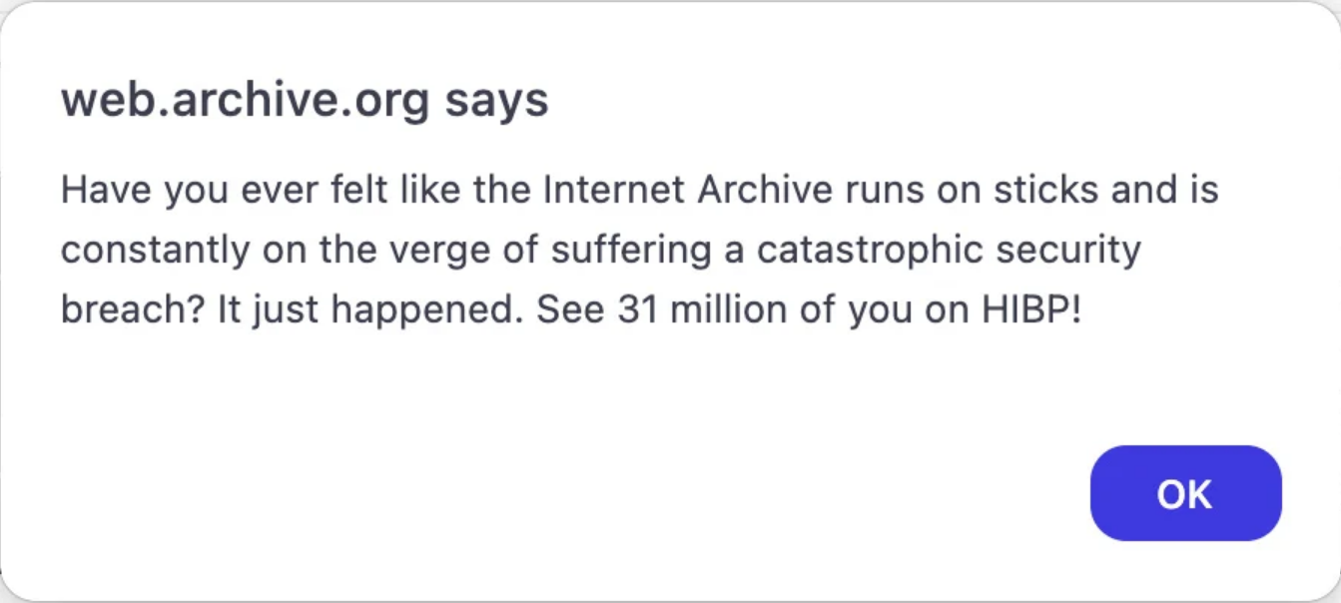
The day of the attack
Notes:
The day of the breach, hackers left an alert on IA’s main page
The message included (screenshot of the alert)
HIBP = Have I Been Pwned, Created by Troy Hunt, a lot of stolen data can be found here

Slide 9
Exposed information
SQL file sized 6.4GB full of user account information
Zendesk support email system
800k+ support tickets since 2018
Notes:
SQL file sized 6.4GB including user account information
Since users can file copyright of privacy complaints, they must provide their Ids. You can see where this is going...
Keep your Gitlab and Github secrets actually secret...

